Slide 1

Welcome to Homefield C of E Primary School.
Thank you for choosing us!
Our Vision
‘Curious Minds, Open Hearts, Joy of Learning’.

Slide 2
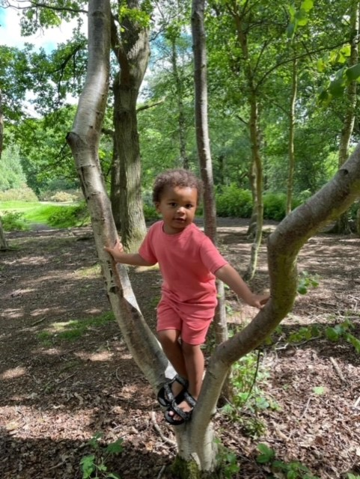
“Welcome to our School”
Miss Kerry Read - Headteacher
“We believe that all children are unique, they have the right to create and lead their own learning pathways. We aim to achieve this through an inspiring environment that ignites curiosity, facilitated by highly skilled adults that nurture, care and educate”

Slide 3
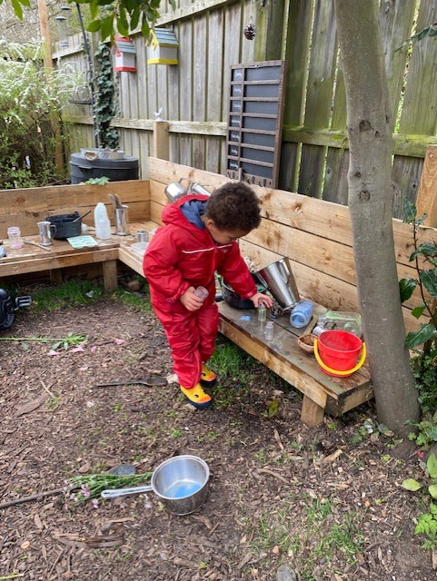
The importance of learning through play
Research supports our practice:
‘Play is not ‘another subject’, not something ‘other than’ the curriculum – it is the way in which most children will access and learn the stuff of the curriculum in the most effective way’
‘It is as they play that children bring together everything they think about feel about and know of people and their lives as a whole. We could say that play co-ordinates a child’s learning. It helps children to make sense of what they learn’
Tina Bruce -Tuning into Children

Slide 4
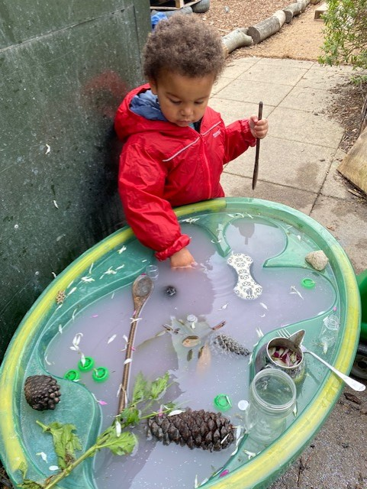

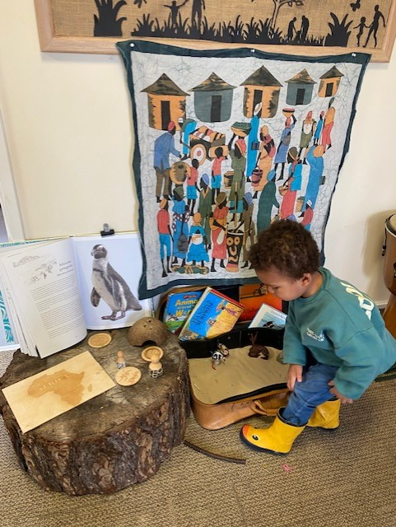
Our Core Christian Value
We embrace diversity and celebrate difference

Slide 5
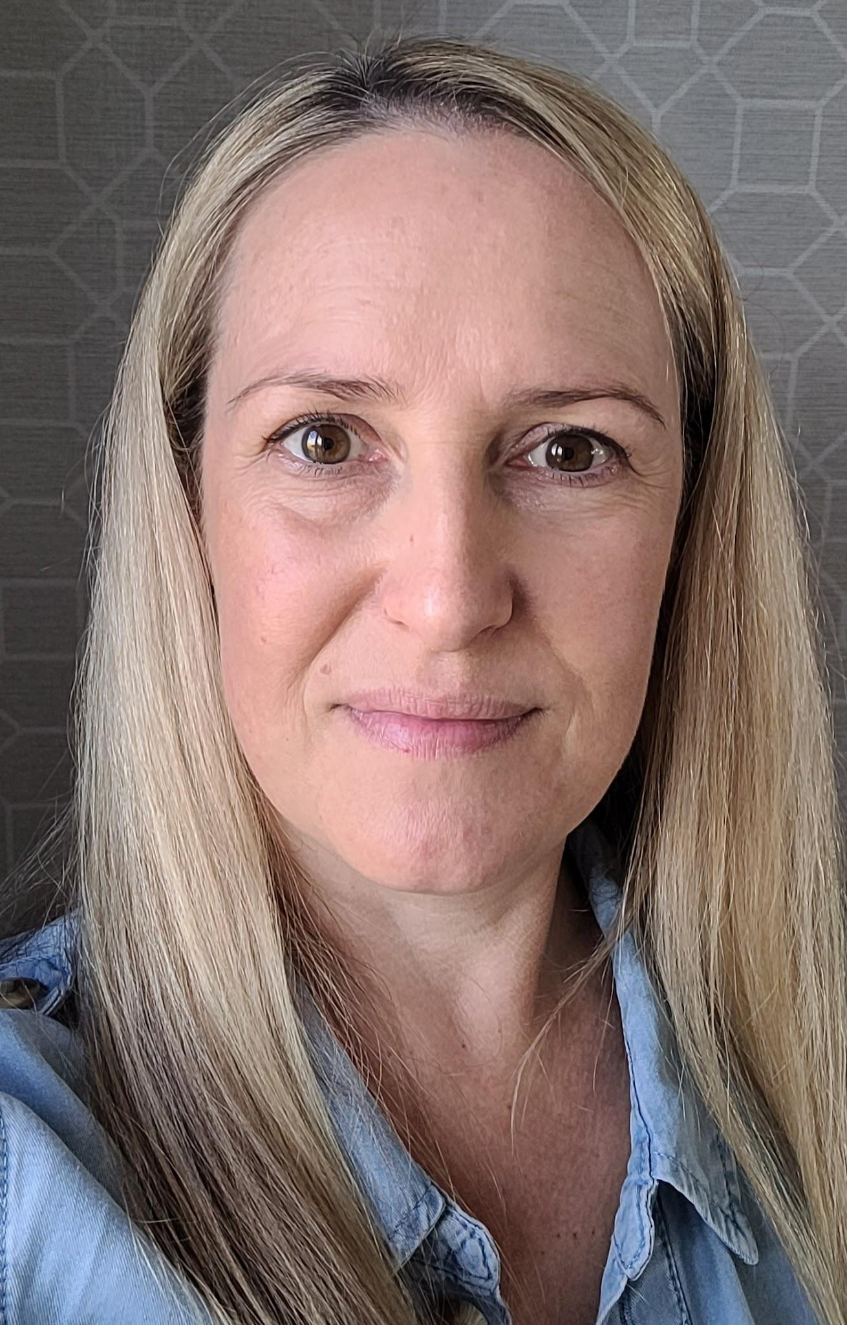
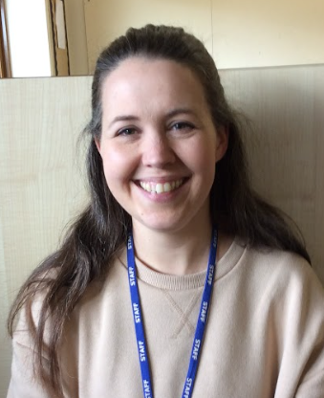
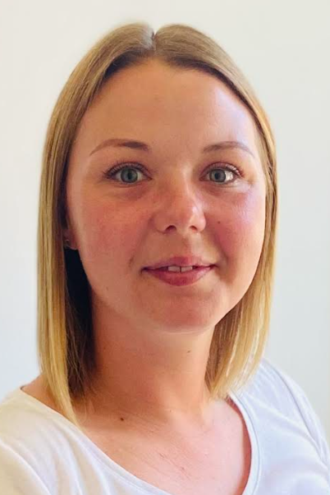
Miss Buck - Class Teacher
Monday - Friday
Miss James - Teaching Assistant
Monday - Friday
Mrs Monk - Teaching Assistant
Monday - Friday
Meet the team!

Slide 6
The importance of transition
We pride ourselves on ensuring the smoothest possible transition into school. We love our job and aim to provide your child the best care and education. We are also all parents, so we understand!
You as parents, are the most important person in your child’s life so we aim to work together with you, to support your child and their individual needs.
It can be a difficult time for parents, especially if this is your first child starting school. (If it’s your second child, you might be skipping off down the road!) You may have your own worries so please share these with us as we are here for you as much as we are here for your child.
Communication
Tapestry (our online learning journal) is our main communication tool. Please use this to share photos of events, celebrations, holidays and home learning.
In person, call or email the school office - office@homefieldprimary.co.uk with any other questions that you may have and to report absence from school.

Slide 7
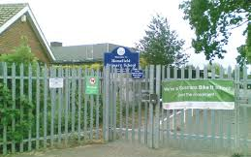
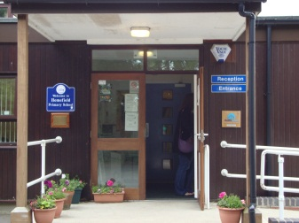
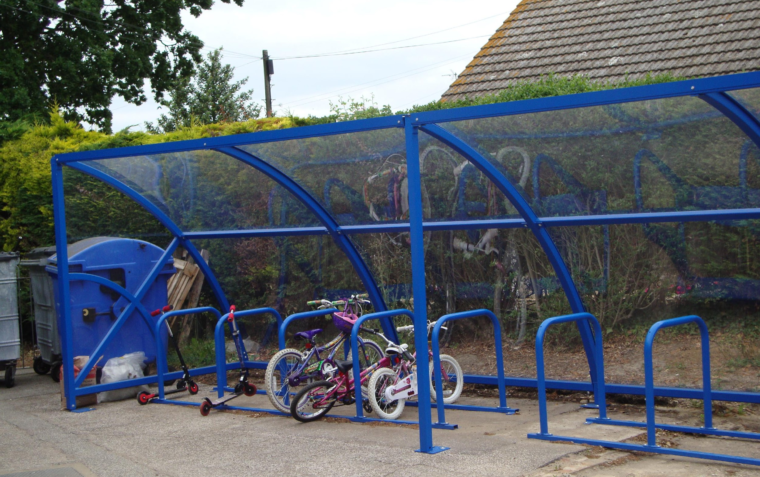
Arrive and collect from the blue bike shed.
Office staff will help you with any enquiries.
,
Where do I go?

Slide 8
The School Day:
Arrive @ 8.40am (Blue bike shed)
Registration @ 8.50am
Phonics 9am (whole class)
Snack is provided from 9.30 - 10.30am (help yourself)
Learning in the provision - Inside & Out freeflow
Maths (whole class)
Lunch time @ 11.45
Learning in the provision - @ 1.00pm Inside & Out freeflow
Story, songs, rhythm and rhyme @ 3pm
Hometime @ 3.10pm (Blue bike shed)

Slide 9
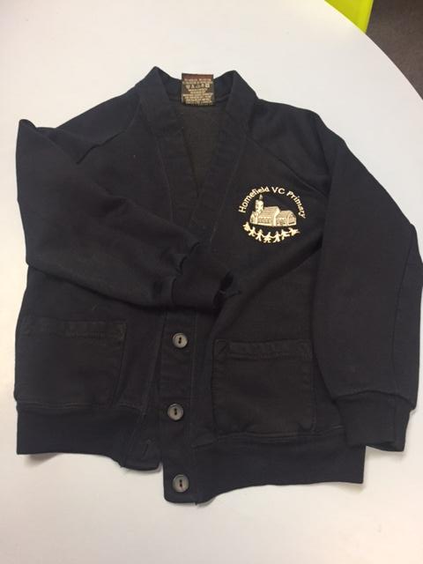
What should I wear?
Navy Fleece (£13) or cardigan (£11.95) from Harrisons or any other plain Navy cardigan/Fleece
White/Light blue polo shirt
Navy or grey trousers, skirt or dress (elasticated waist)
Preferably shoes with Velcro to encourage independence.
We will be outside; climbing, digging, planting, painting etc, so your child will get messy! Uniform needs to be comfortable and practical.
Coat, Sun hat and Wellies
PE sessions will mean coming to school in navy shorts/joggers, blue polo shirt, navy fleece or jumper and trainers. - We will let you know our PE day soon.

Slide 10
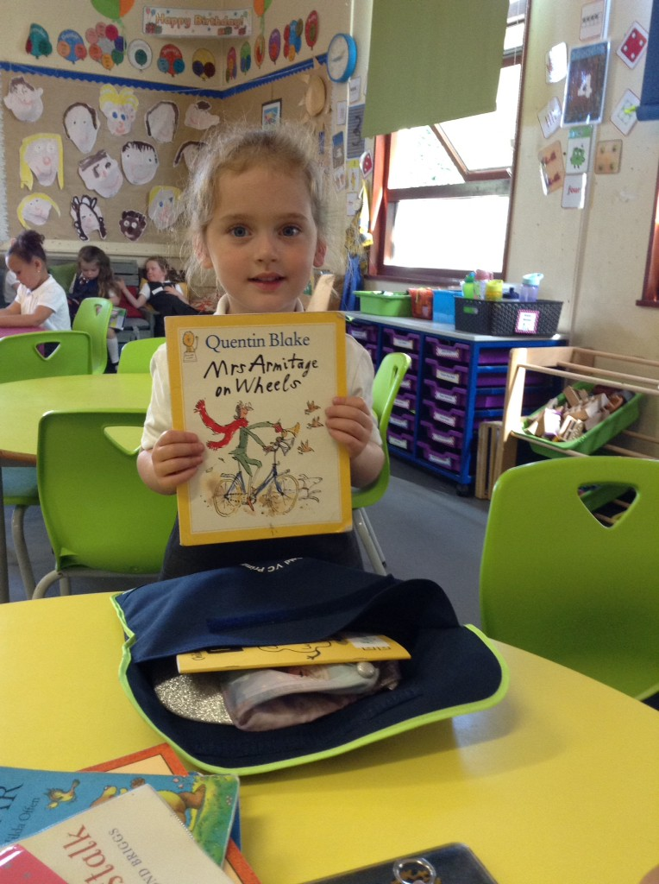

What do I need? – A spare change of clothes…or two! A bookbag, and weather appropriate clothing – Coat, sun hat etc.
Please Name everything!
Bookbag from Harrisons = £5.95
Water bottle

Slide 11
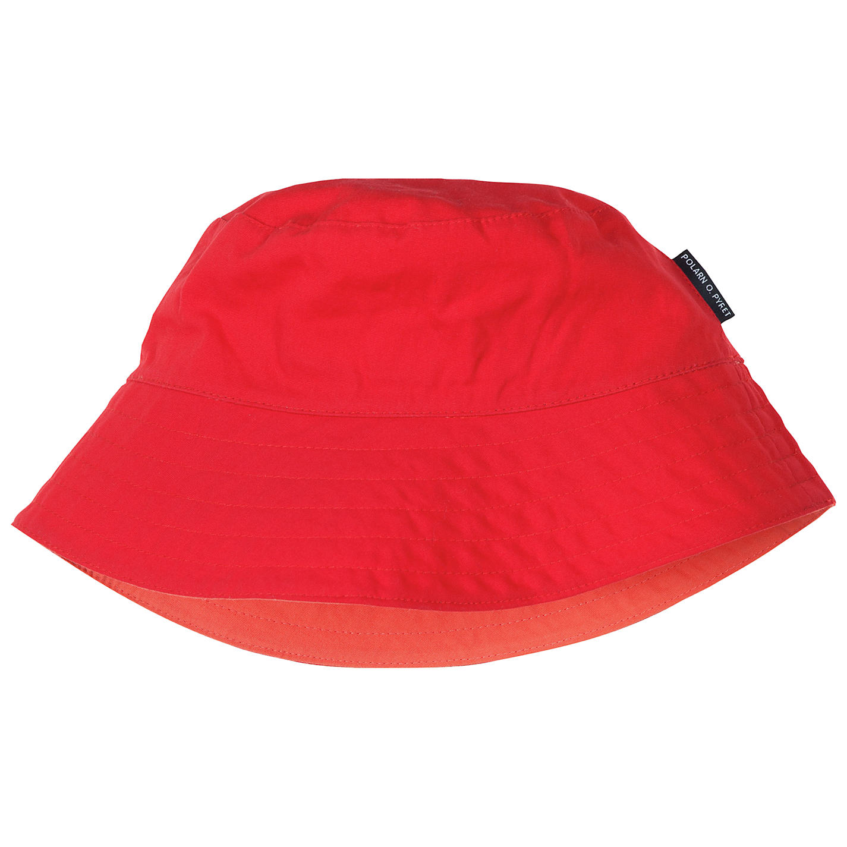
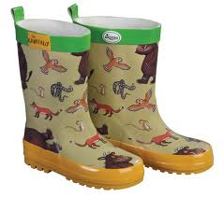
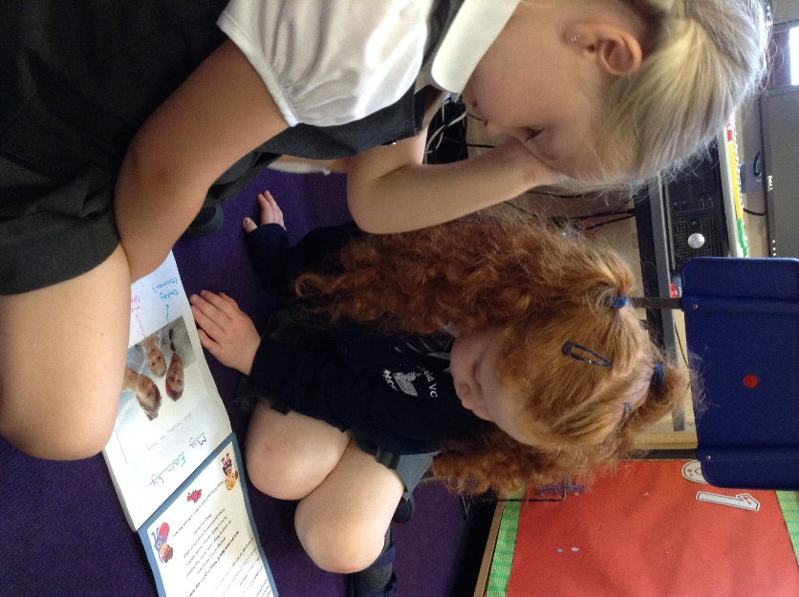
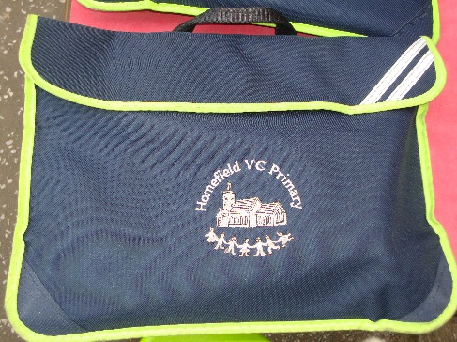
You will need to bring..
Book bag and water bottle
(add a small keyring to your bookbag so you know it is yours)
Wellies
Waterproofs / suncream / sunhat
Change of clothes for water or toilet accidents
All about me books on first day

Slide 12
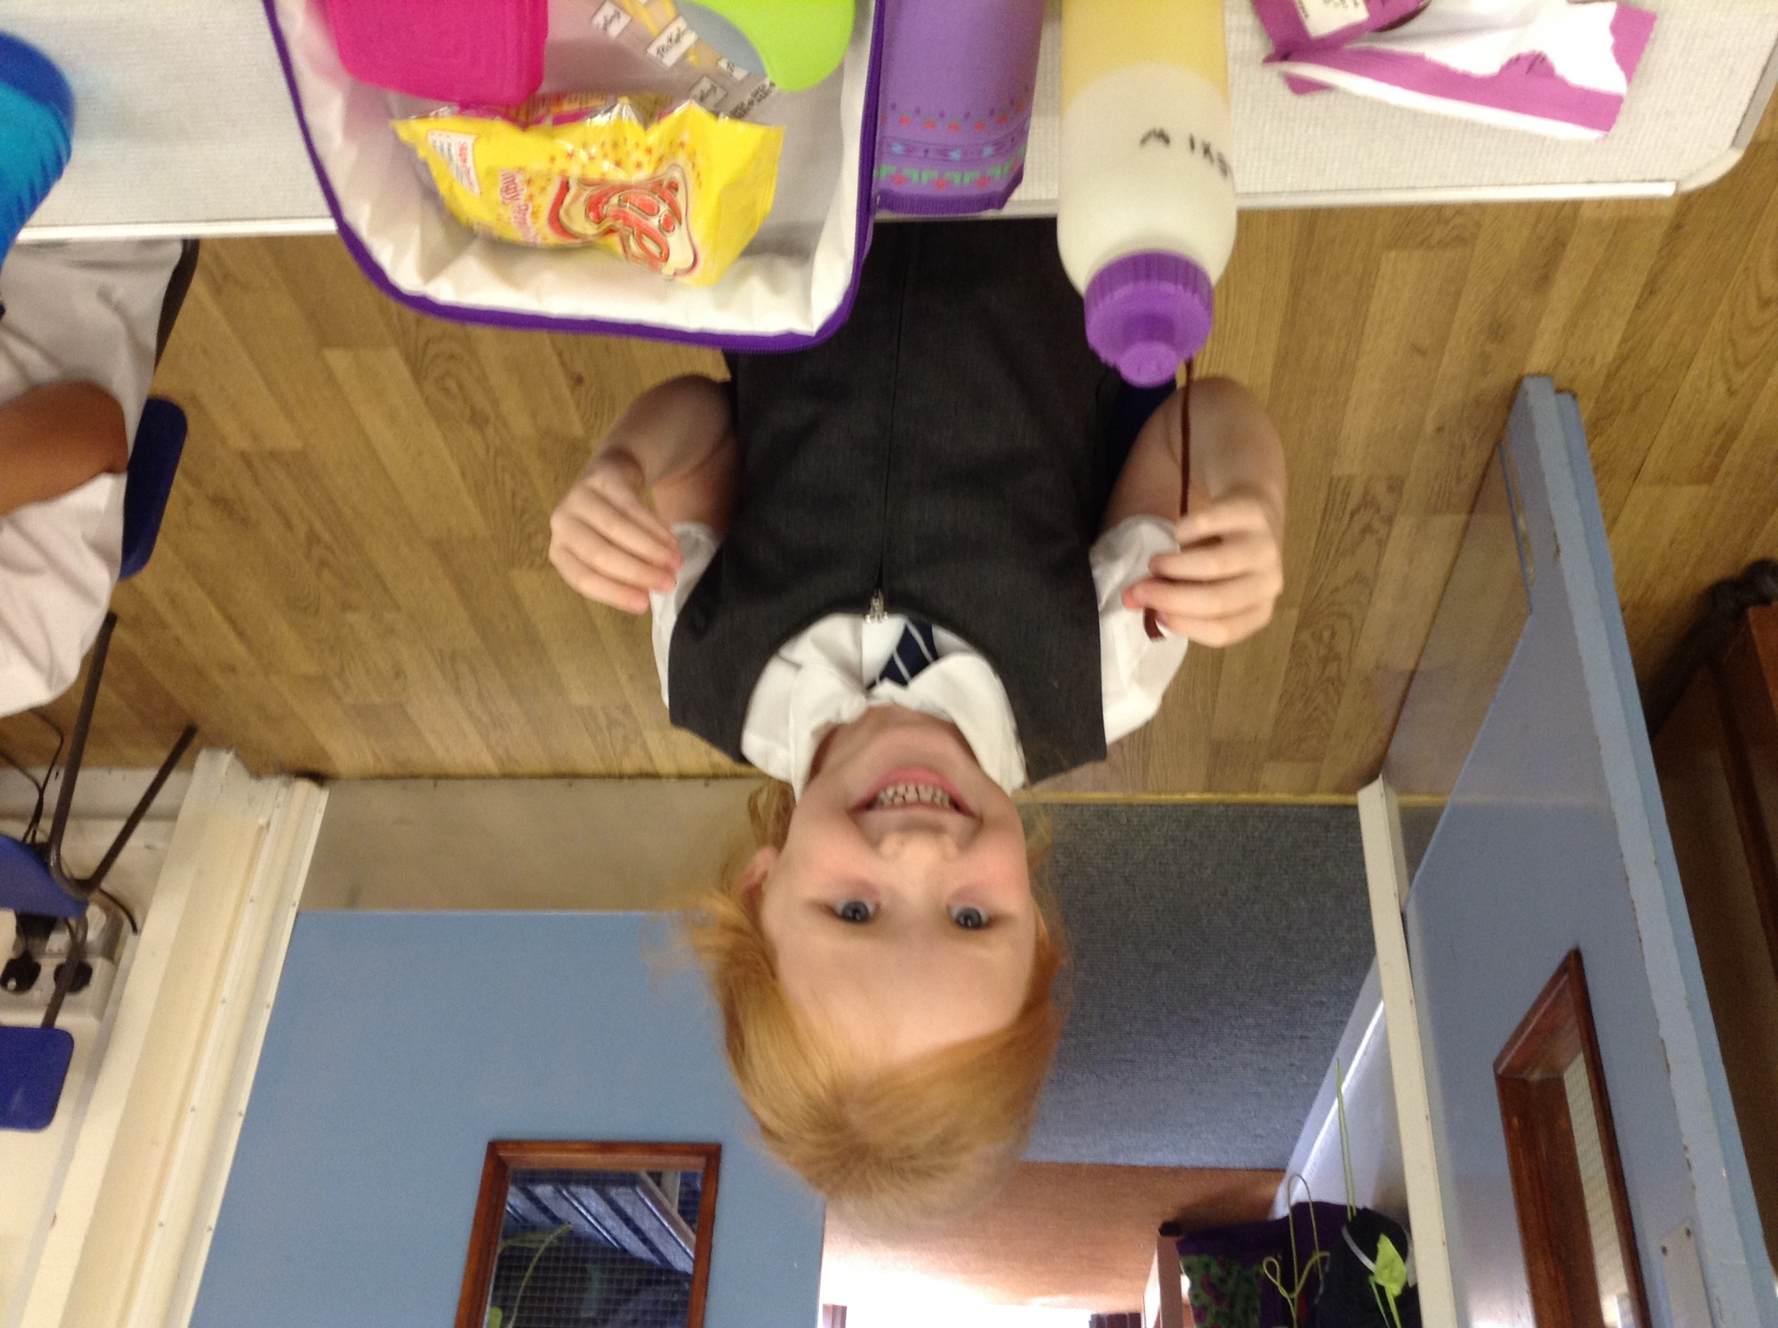
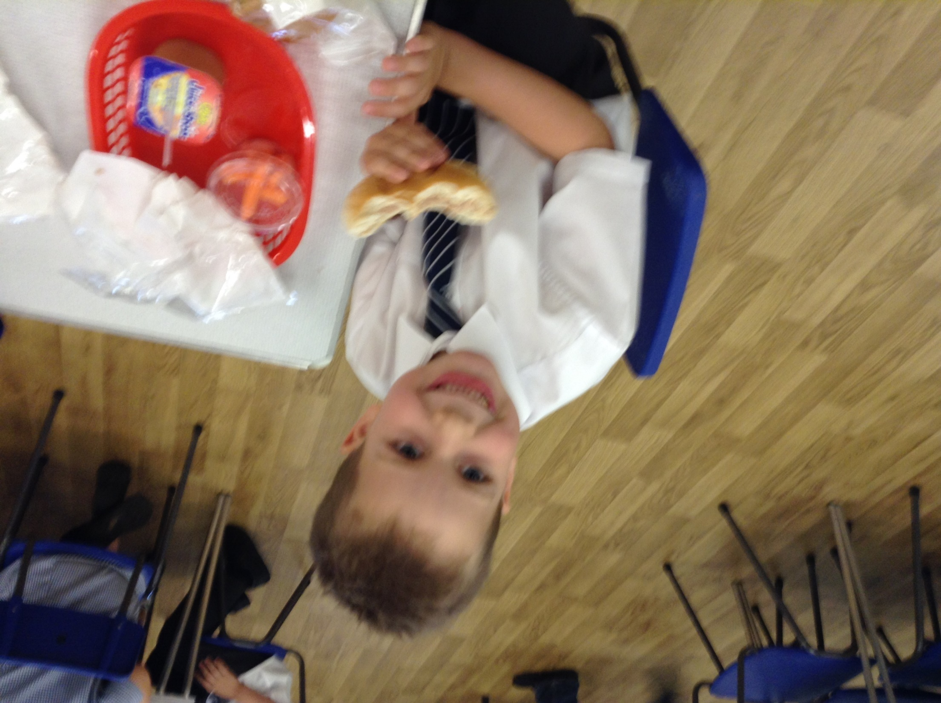
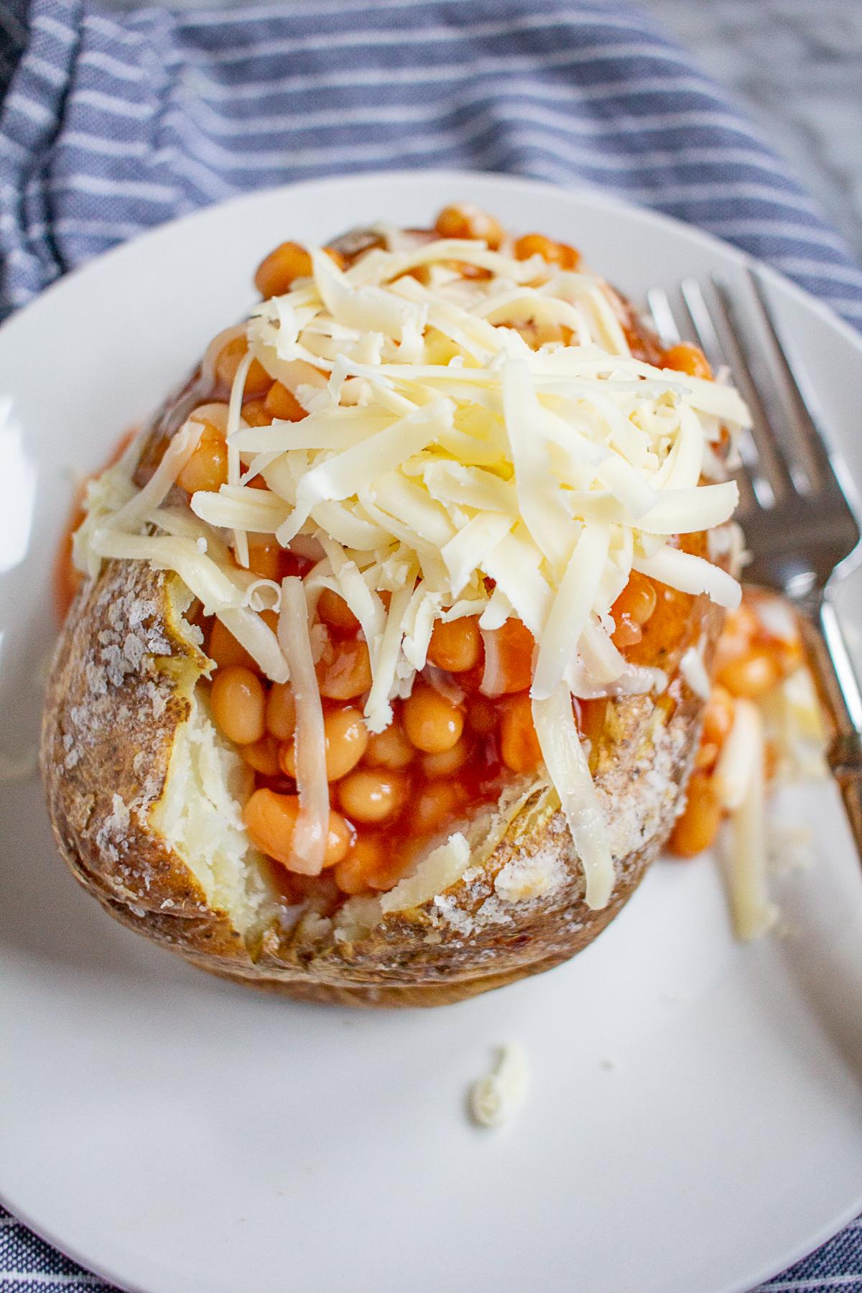
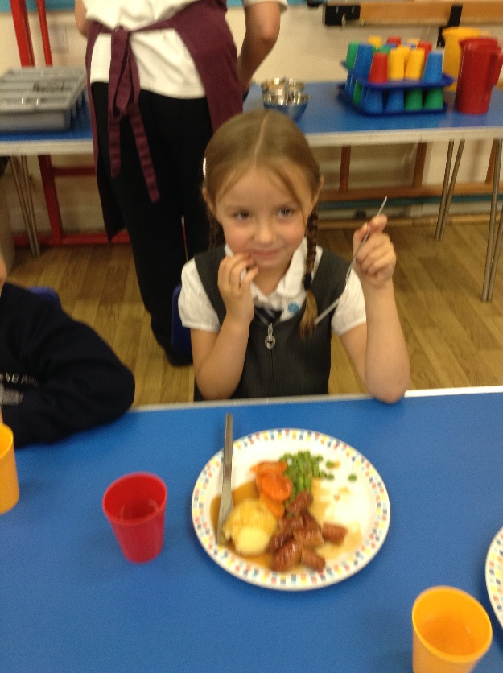
Lunches
All Reception children are entitled to a free school lunch. A menu is provided showing the hot meal, vegetarian option, jacket potato (Cheese, Beans or Tuna) or a school packed lunch (Ham, Cheese or Tuna). These can be chosen on the day.
We are a nut free school

Slide 13
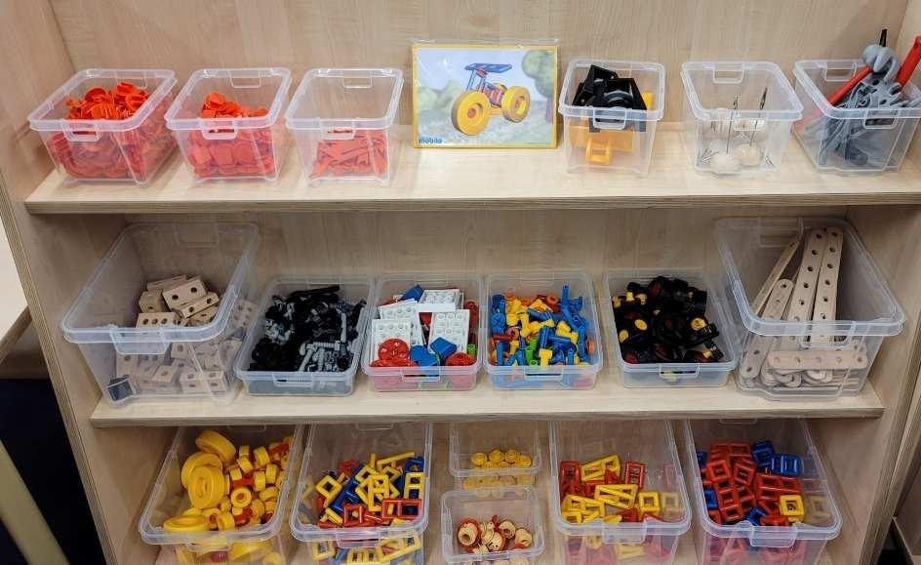
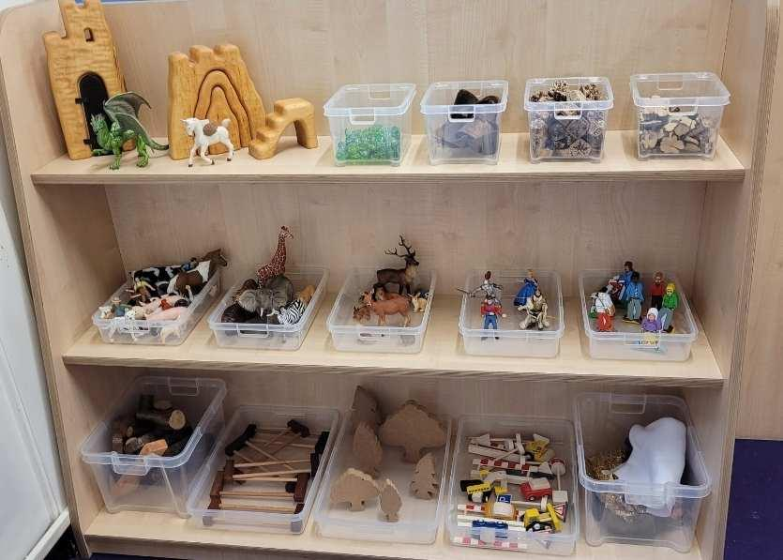
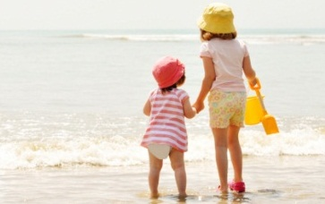
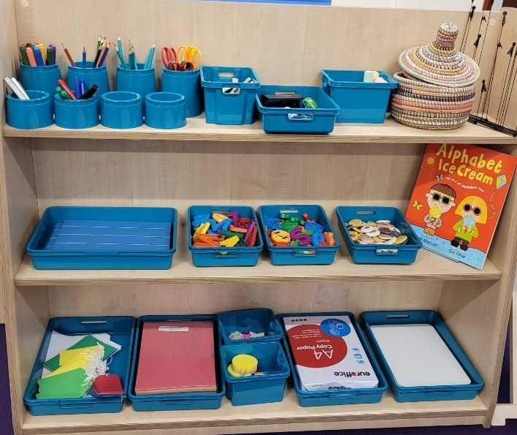
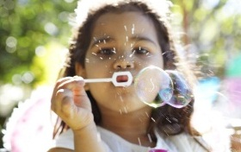
We were very fortunate to receive funding for a whole new set of classroom resources!
Notes:
NOTE: To change images on this slide, select a picture and delete it. Then click the Insert Picture icon in the placeholder to insert your own image.

Slide 14
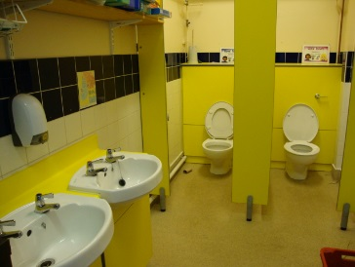
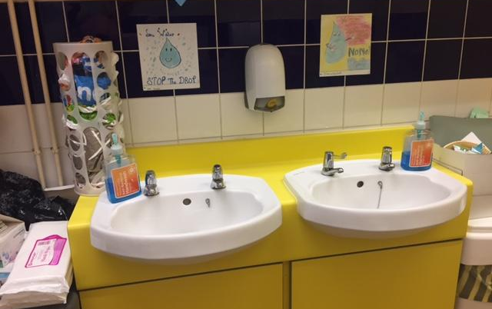
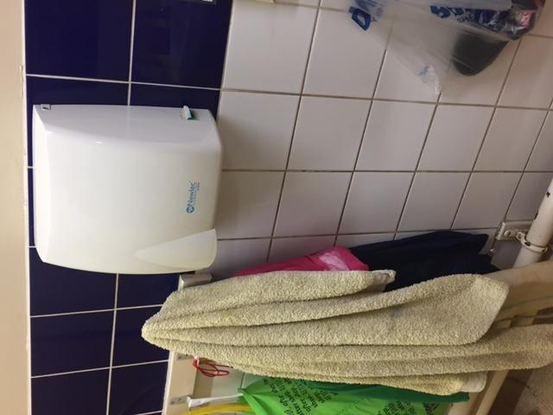
This is our bathroom, we don’t need to ask to go to the toilet we can just go when we need to, there is always lots of soap to use and paper towels if we find the dryer too noisy.

Slide 15
Some notes for parents
Please let us know of anyone if anyone else is picking your child up even if it is a regular arrangement. A photo of this person could be added into the ‘All About Me’ Book.
Please name EVERYTHING!
Shoes that the children are able to do themselves
Shoe uniform that they can manage themselves
Cardigans and fleeces as opposed to v neck jumpers (so much easier to manage)
Spare clothes – accidents happen!

Slide 16
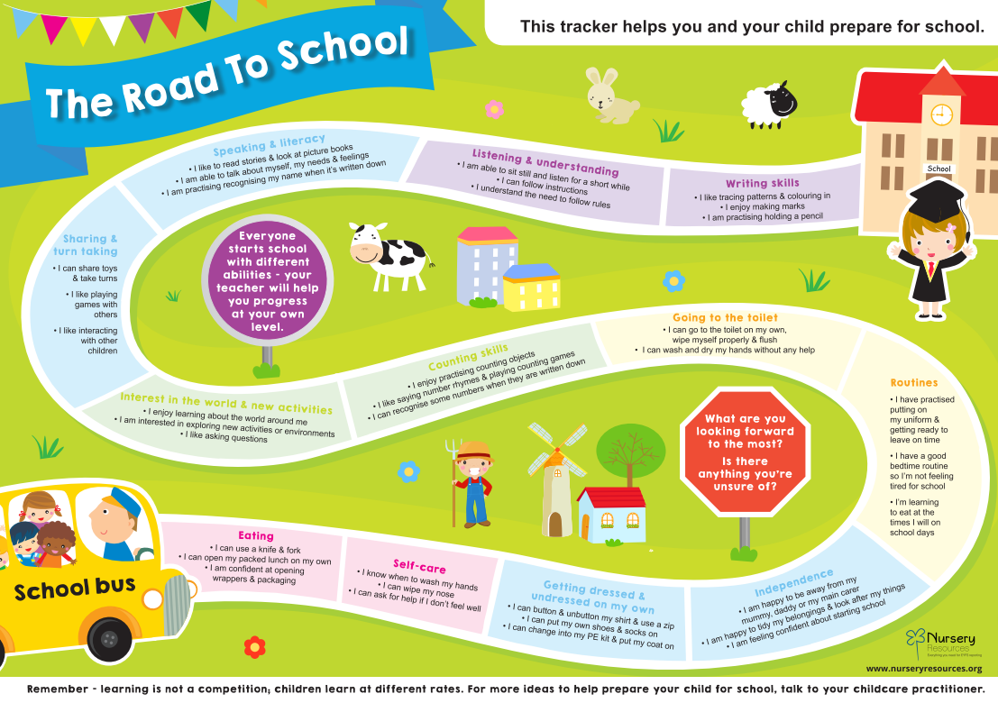
How else you can help during the holidays

Slide 17
What can I do to help at home?
Practice putting on coats & shoes
Toilet- independently
Help to use a knife and fork
Read lots of stories, rhymes and sing together
Explain what will happen. Drop off briefly and be positive
Enjoy the summer together.
Fill in their ‘All About Me’ books.

Slide 18
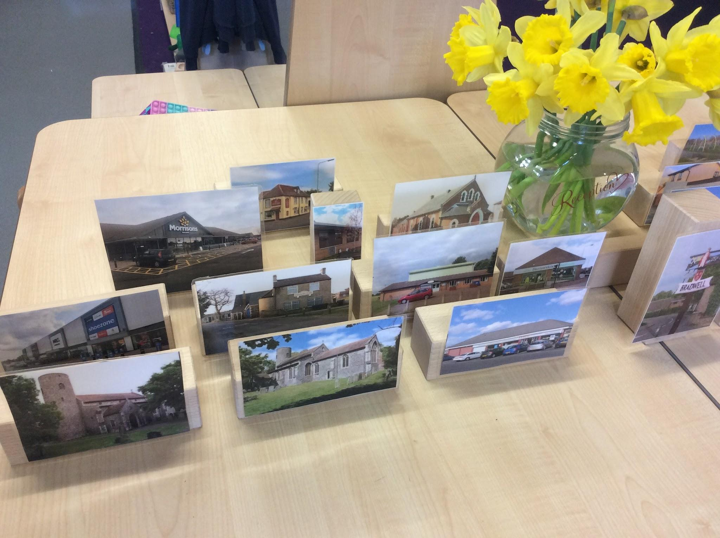
We look forward to starting our journey together in September
Have a fantastic summer and we look forward to reading all about it in your ‘All About Me’ book.

