Slide 1
How children with SEND are supported at Homefield
Monday 6th November
Miss Scarlett Everett SENDCo
Mrs Lynn Lees SEND Governor

Slide 2
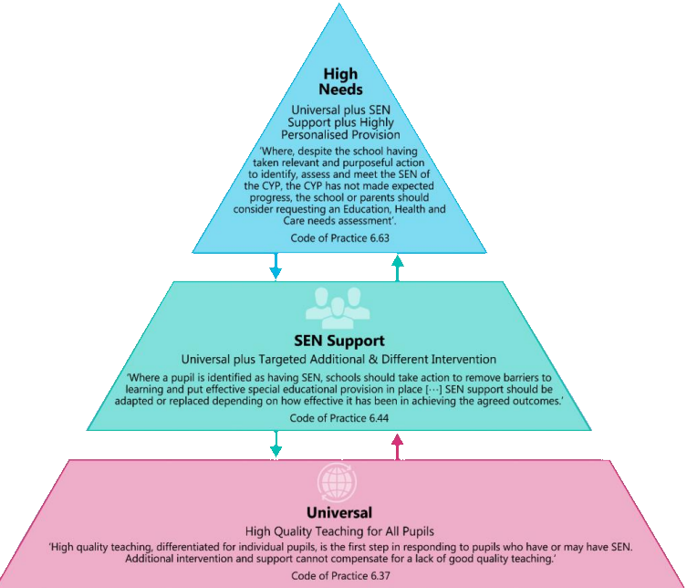
The Graduated Approach

Slide 3
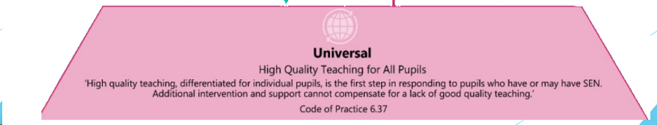

Evidence-led approach that focuses on how children learn best
Lessons are chunked – small steps – I do, we do, you do – active and engaged
Reduces the cognitive load on pupils
Specific vocabulary instruction – repetition and revisits to make connections
Knowledge Organiser as an overview of key learning for that topic
Knowledge Notes for every lesson – key information, dual coding, adapted, flick back to
Sequence across the school allows children to become ‘a little more expert’

Slide 4

Visual timetables
Writing frames
I-pads, laptops or alternative recording devices
Digital spell checkers
Electronic reading pens
Reading overlays or different coloured paper
Larger texts
Adapted writing tools
Consideration of lighting in the learning environment
Peer buddy systems
Talking tins to record voices
Now and Next boards
Symbols and visuals to support learners
Calm spaces in classrooms
Standing desks
Positive behaviour reward systems
Quiet work stations
Attention to seating position within the class
Word mats
Sentence stems
Worked examples
Different methods of recording – drawing/annotations
Pre-teaching
Model texts to see ‘what a good one looks like’ (WAGOLL)
Classrooms uncluttered
Neutral displays
Zones of Regulation
Targeted group support

Slide 5
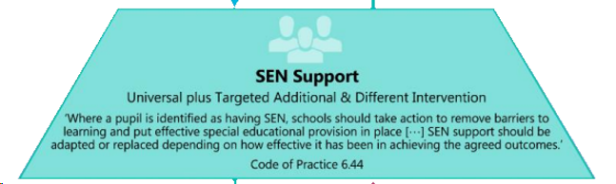
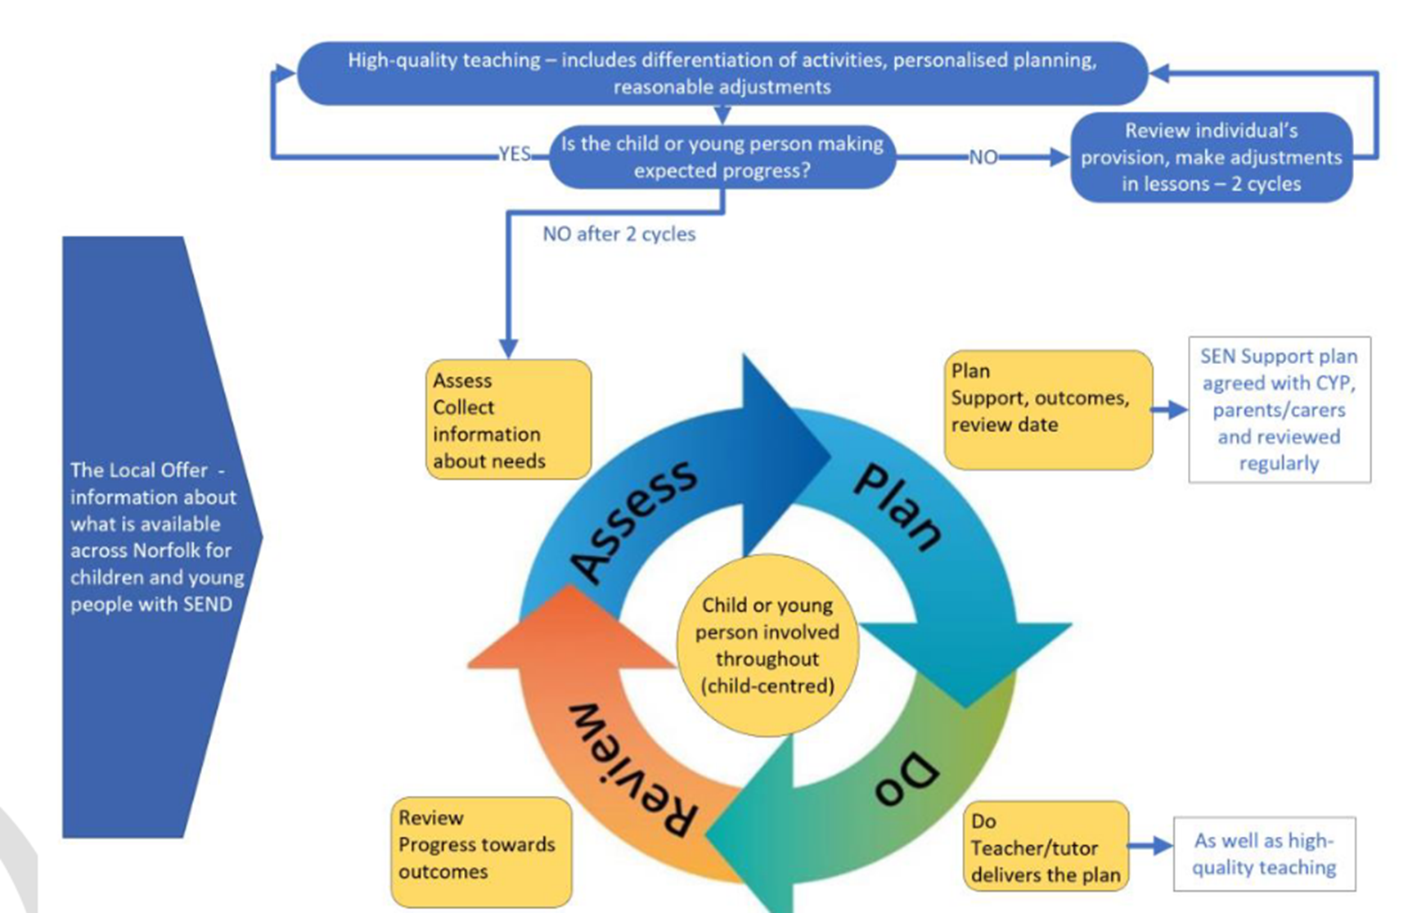


Any concerns? Talk to your child’s class teacher!
Core Consultations
Mrs Howard!
Early Identification

Slide 6
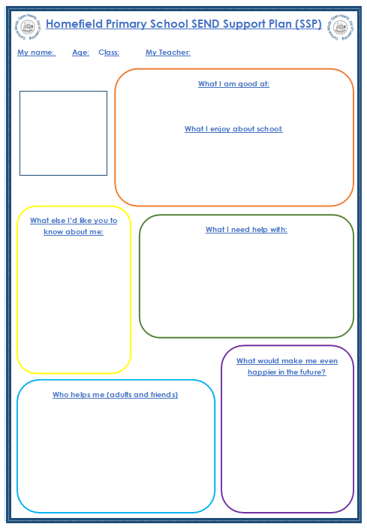
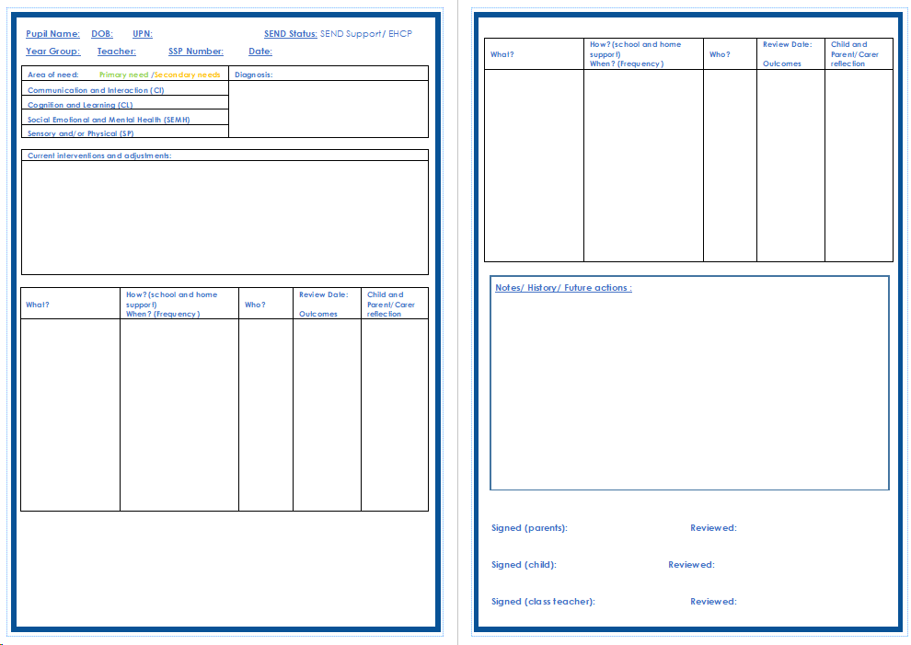

Slide 7
Interventions (an ever-expanding list!)
WellComm – Communication intervention
Talkabout – Communication and Interaction intervention
FFT Phonics – phonic, spelling and reading intervention
Fine and Gross Motor Skills
1st Class Number/ Third Space Learning
Attention Autism*
Thrive
Targeted intervention at a specific skill – precision teaching

Slide 8
Services referable by schools
Services available to parents
Educational Psychology
Speech and Language
Autism Team
Social, Emotional and Mental Health Team (SEMH)
Specialist Learning Support Teacher (SLST)
Community and Schools Team
Dyslexia Outreach Service
Virtual School Sensory Support
Specialist Resource Bases (SRBs) – Hilllside, Edward Worlidge, Southtown, Caister Oceans
Schools 2 Schools – specialist school support
Occupational Therapy (Physical difficulties) - GP
Newberry Clinic (Community Peadiatrics – ASD/ADHD Referrals) - GP
Physiotherapy – GP
Virtual School Sensory Support
Early Help
Just One Norfolk
Community and Schools Team
SENDIASS
Early Childhood Family Service (ECFS)
https://communitydirectory.norfolk.gov.uk/Information/sendneweducation

Slide 9
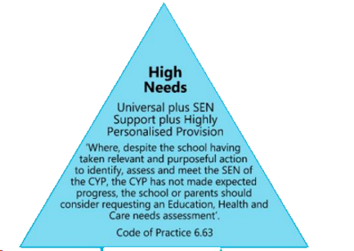
https://www.norfolk.gov.uk/children-and-families/send-local-offer/education-and-learning/support-for-learning/education-health-and-care-ehc-plans/ehc-needs-assessment-and-plans/what-is-an-ehc-plan
If the child needs support beyond the PEASS guidance then a referral for an Education, Health and Care Plan (EHCP) may be necessary.
Both parents and schools can apply for an EHCP.
May need extra training, resources, support in school to support this.
Funding is based on the child’s need - rare it will suggest a child needs a 1:1.
https://www.norfolk.gov.uk/children-and-families/send-local-offer/education-and-learning/schools/sen-funding-for-schools
Annual reviews – completed with child, parent and professionals.
It is a legal document and lasts until the person is 25 years old.

Slide 10
Helpful Websites
https://www.norfolk.gov.uk/children-and-families/send-local-offer
https://www.justonenorfolk.nhs.uk/
https://www.norfolk.gov.uk/children-and-families/early-help
https://www.norfolk.gov.uk/children-and-families/early-childhood-and-family-service
https://www.norfolksendiass.org.uk/
https://www.norfolksennetwork.org/
https://www.autism.org.uk/
https://adhduk.co.uk/
https://www.bdadyslexia.org.uk/dyslexia/about-dyslexia/what-is-dyslexia
https://dyspraxiafoundation.org.uk/what_is_dyspraxia/dyspraxia-at-a-glance/
https://speechandlanguage.org.uk/
https://www.rnib.org.uk/
https://www.ndcs.org.uk/
https://youngminds.org.uk/
https://www.nasen.org.uk/

